Slide 1

The Microsoft Toolset for Business
The Complete Technology Stack
Notes:
This is the Power Up Training sample presentation that used the ZOOM feature for a table of contents found on SLIDE #2.
Version October 2022. Contact Les@Power-up.training

Slide 2
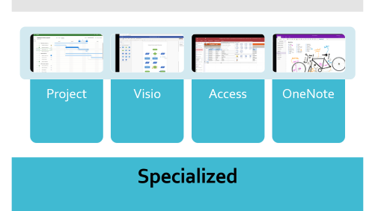
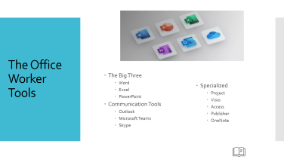
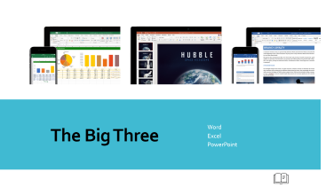
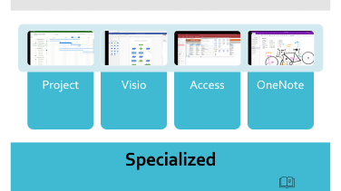
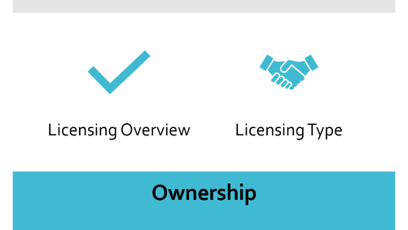
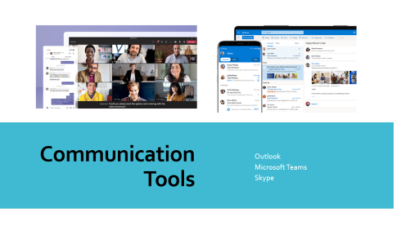

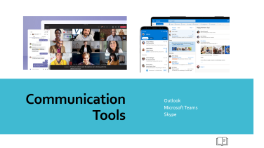
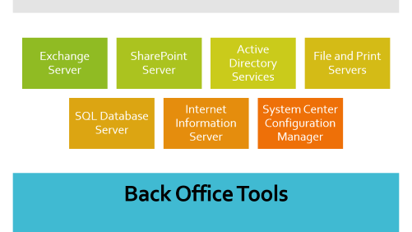
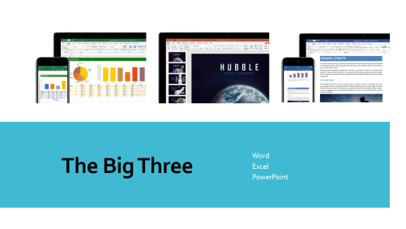
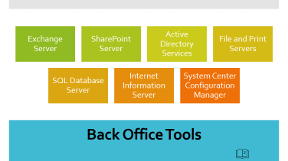
Table of Contents
The Big Three
The Office Worker Tool
Communication Tools
Notes:
Slide #2 is the launching slide with six “Zoom” slides plus the utilization of a hyperlink icon that returns back to this page.
Note that the hyperlink CAN NOT be edited on the slide page, but instead, it is embedded into the SLIDE MASTER.
The training video can be found here: https://www.power-up.training/lesson/powerpoint-table-of-contents/

Slide 3
What are the Business Tools by Microsoft
The Office Worker Tools
  The Big Three
    Word
    Excel
    PowerPoint
  Communication Tools
    Outlook
    Microsoft Teams
    Skype
  Specialized
    Project
    Visio
    Access
    Publisher
    OneNote
Back Office Tools
  Exchange Server
  SharePoint Server
  Active Directory Services
  File and Print Servers
  SQL Database Server
  Internet Information Server
  System Center Configuration Manager

Slide 4

The Office Worker Tools
  The Big Three
    Word
    Excel
    PowerPoint
  Communication Tools
    Outlook
    Microsoft Teams
    Skype
  Specialized
    Project
    Visio
    Access
    Publisher
    OneNote

Slide 5
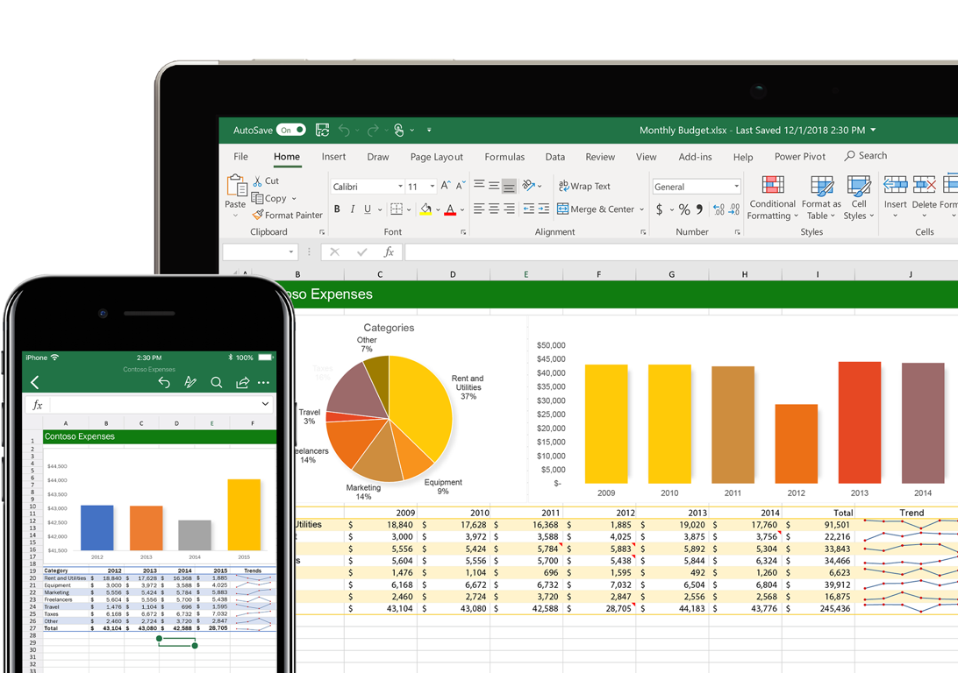
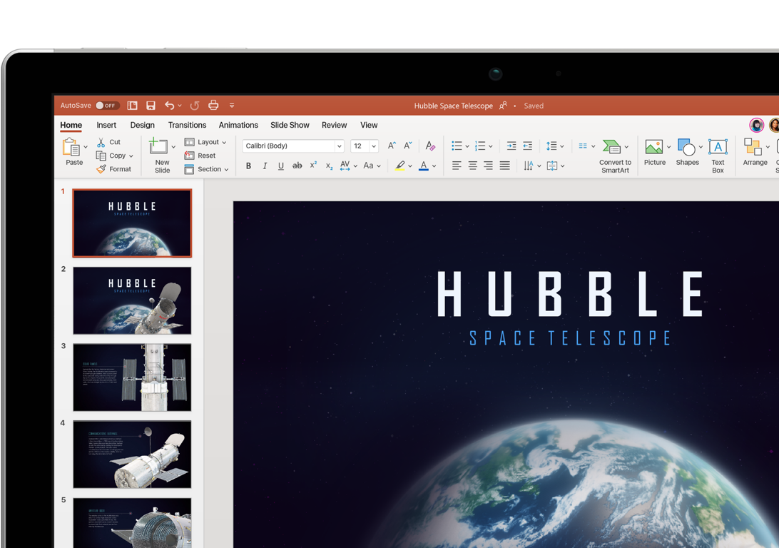
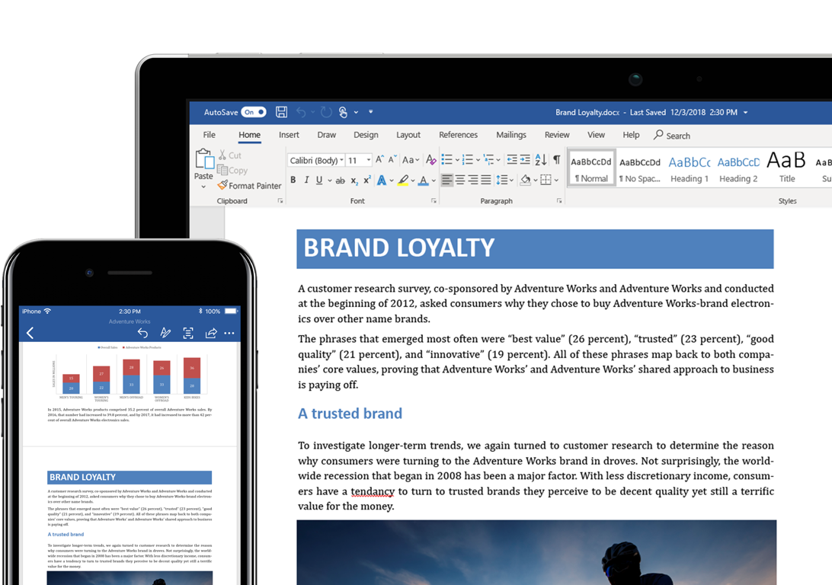

The Big Three
    Word
    Excel
    PowerPoint

Slide 6
Word

Slide 7
Excel

Slide 8
PowerPoint

Slide 9
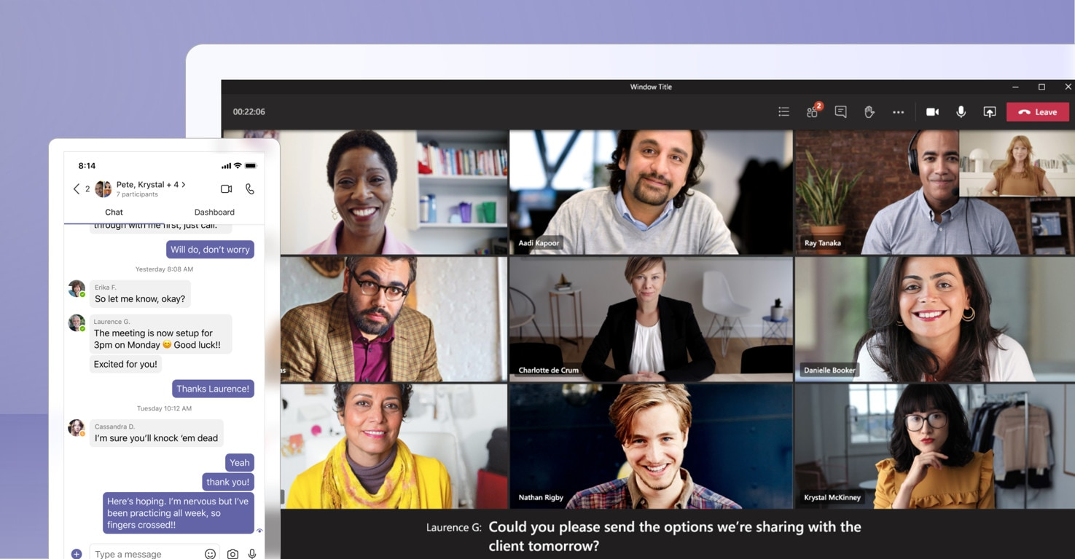
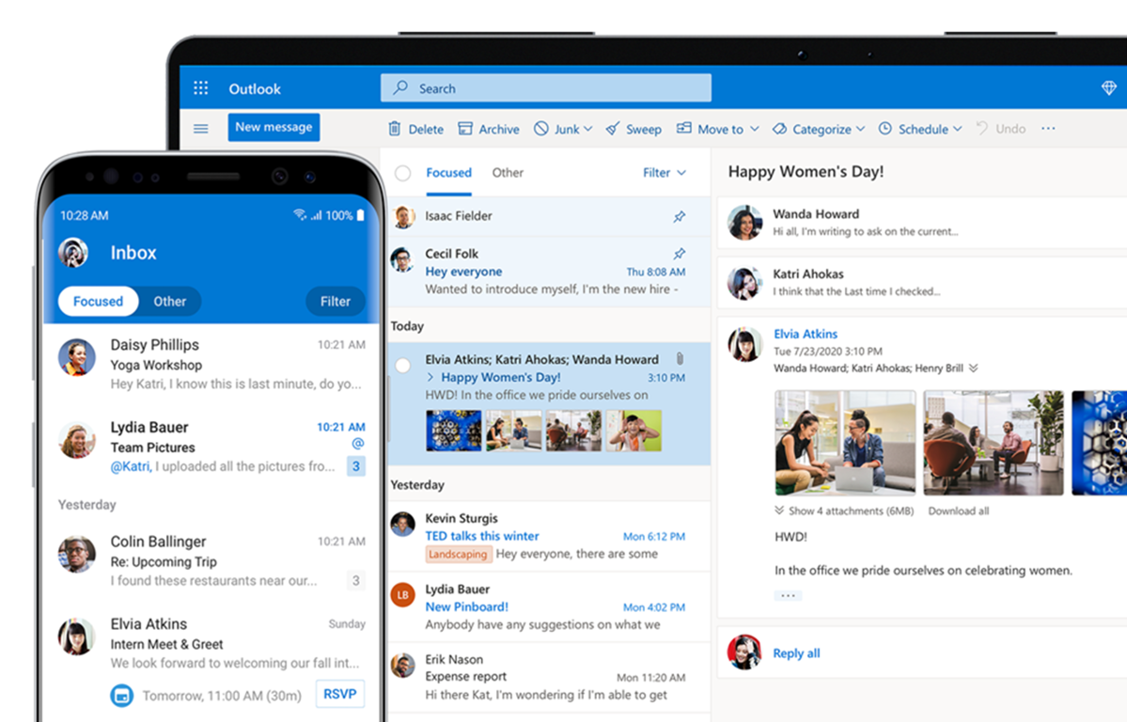
Communication Tools
    Outlook
    Microsoft Teams
    Skype

Slide 10
Outlook

Slide 11
Microsoft Teams

Slide 12
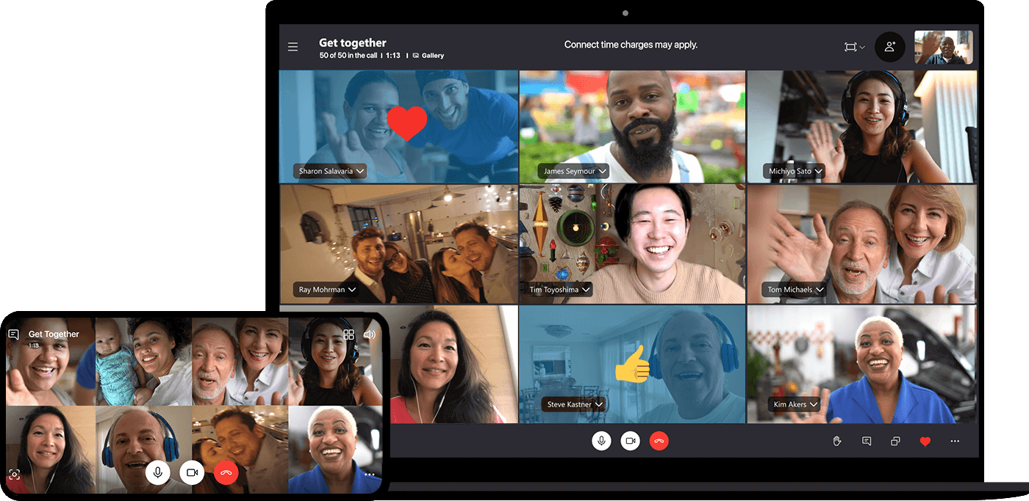
Skype

Slide 13
Specialized
Project
Visio
Access
OneNote

Slide 14
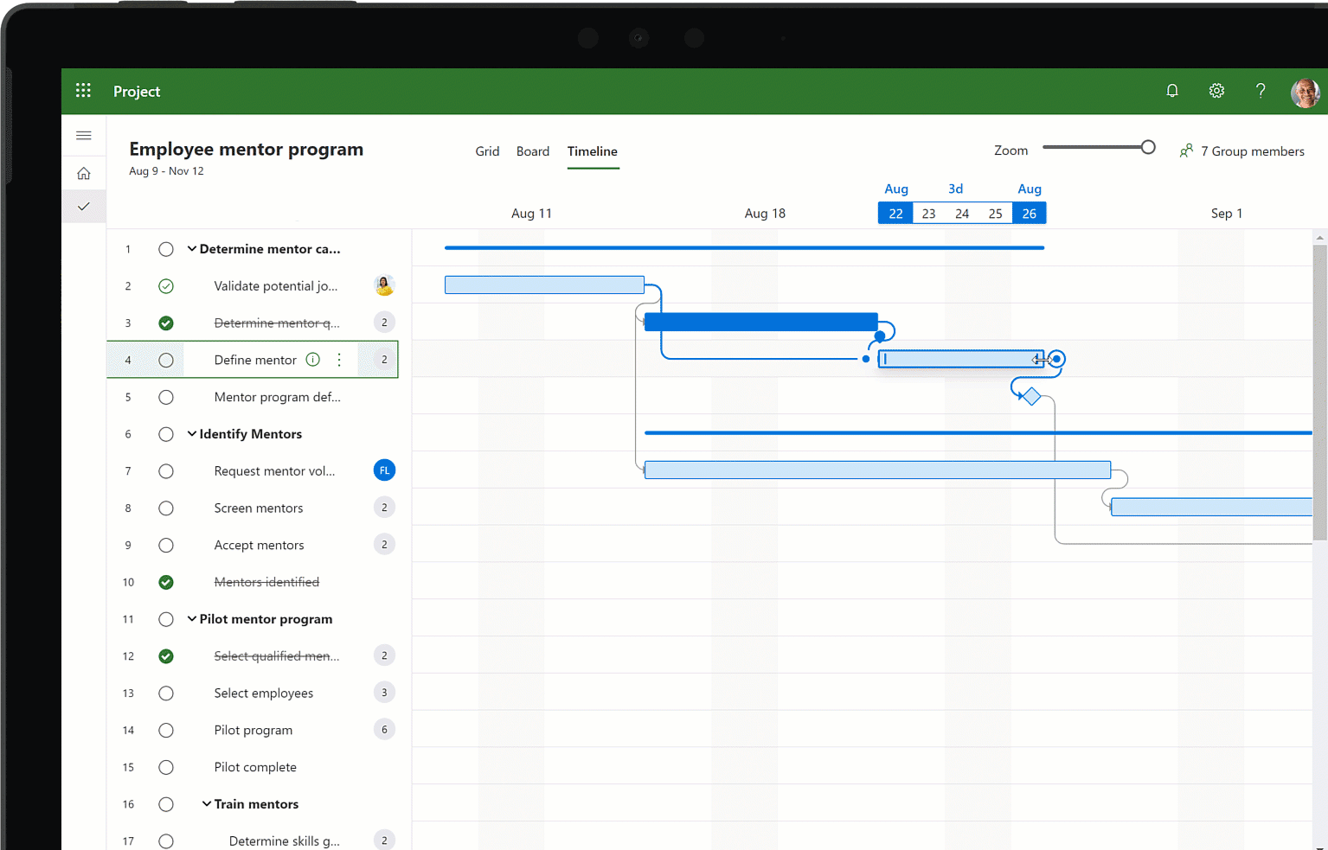
MS
Project

Slide 15
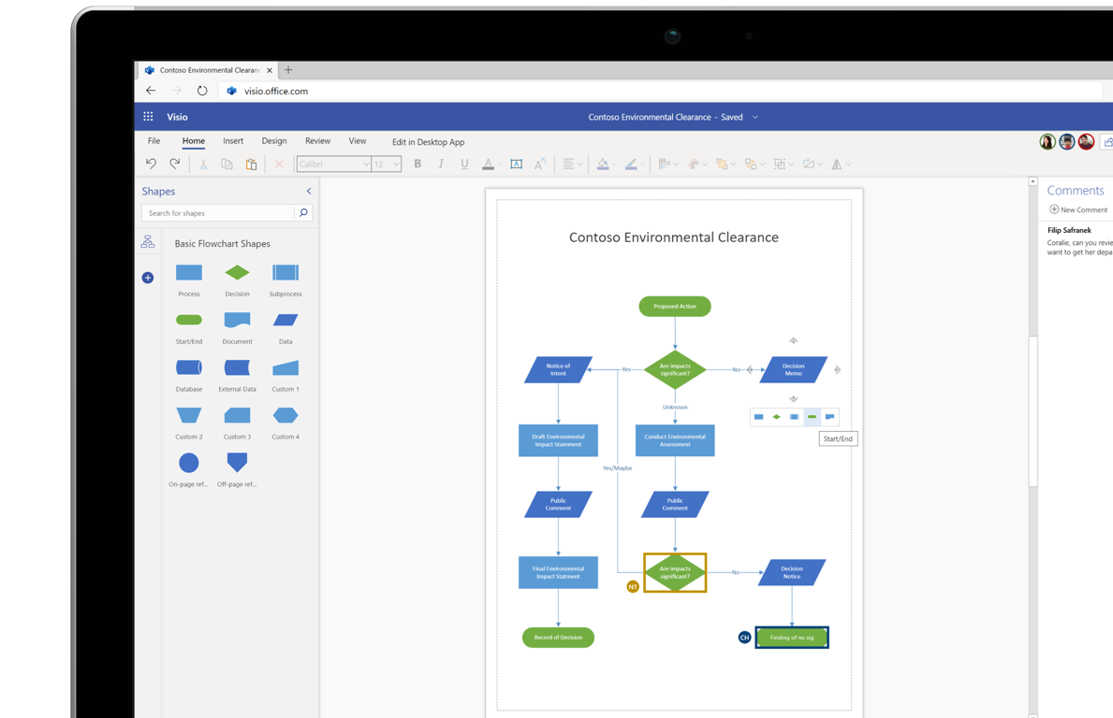
Visio

Slide 16
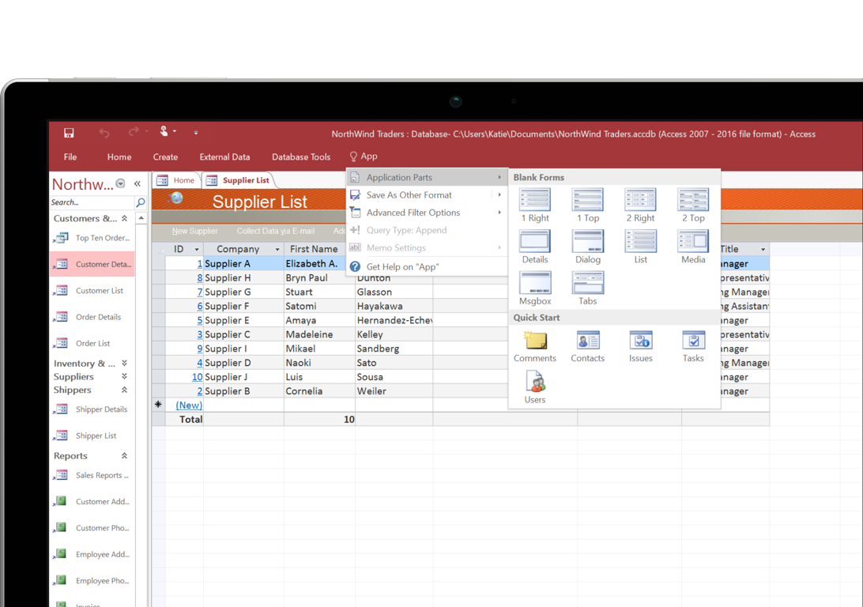
Access

Slide 17
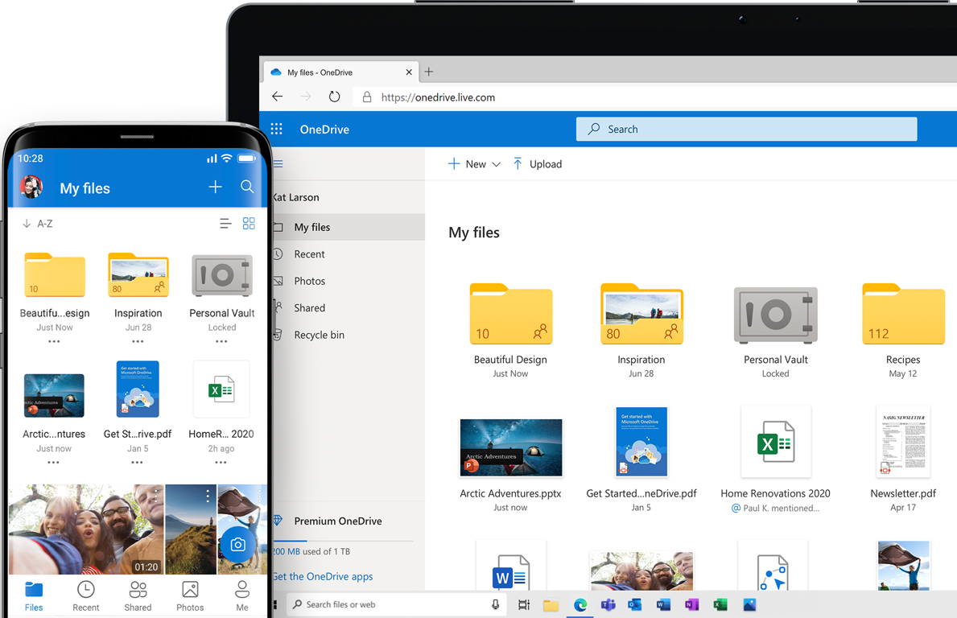
One Drive

Slide 18
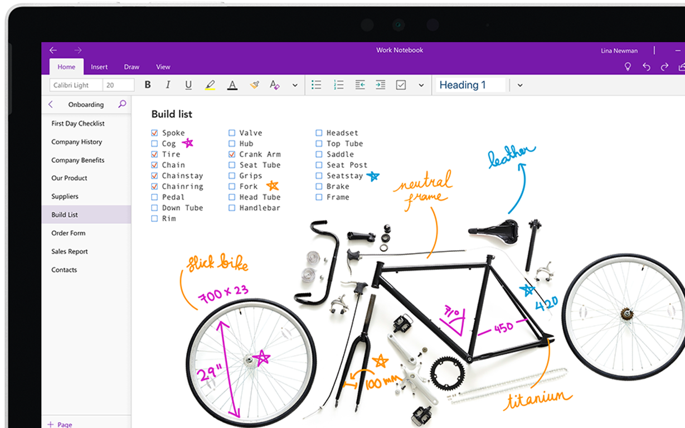
OneNote

Slide 19
Back Office Tools
Exchange Server
SharePoint Server
Active Directory Services
File and Print Servers
SQL Database Server
Internet Information Server
System Center Configuration Manager

Slide 20
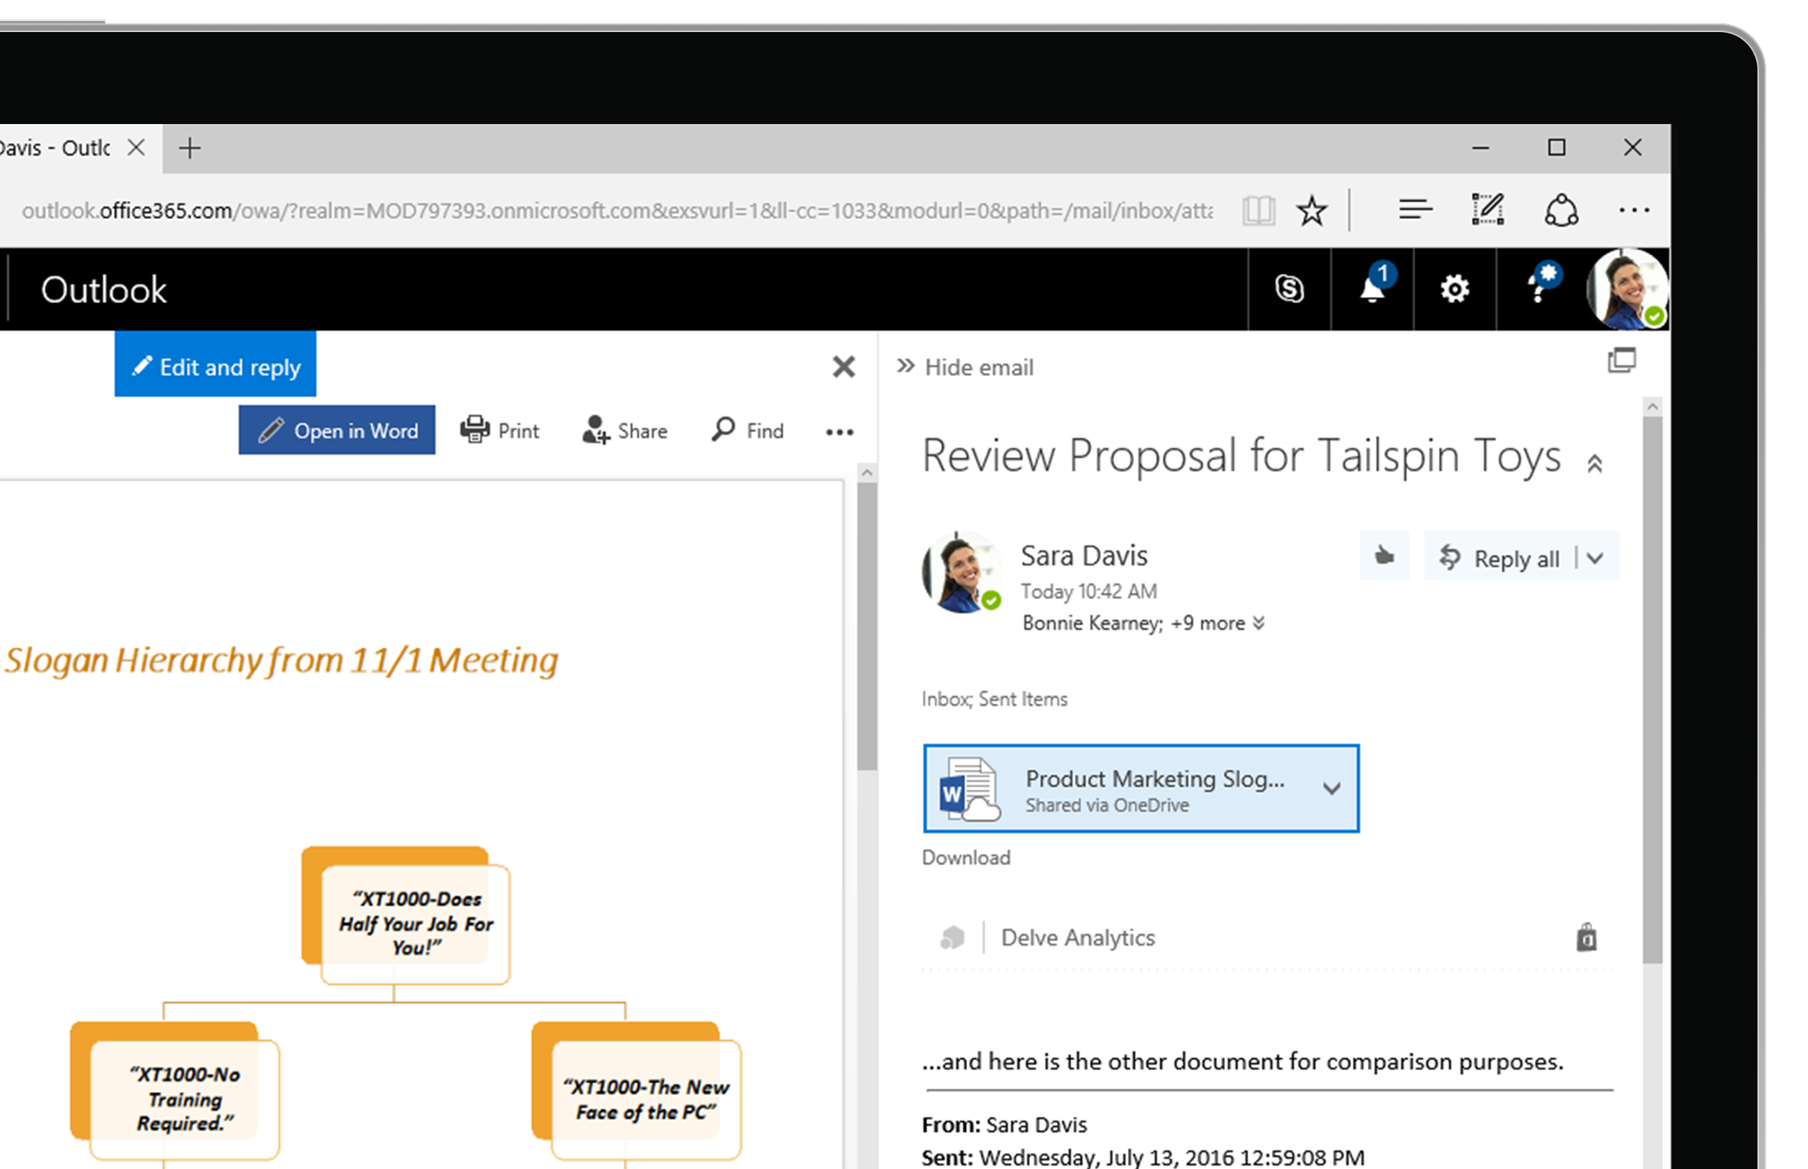
Exchange Server

Slide 21
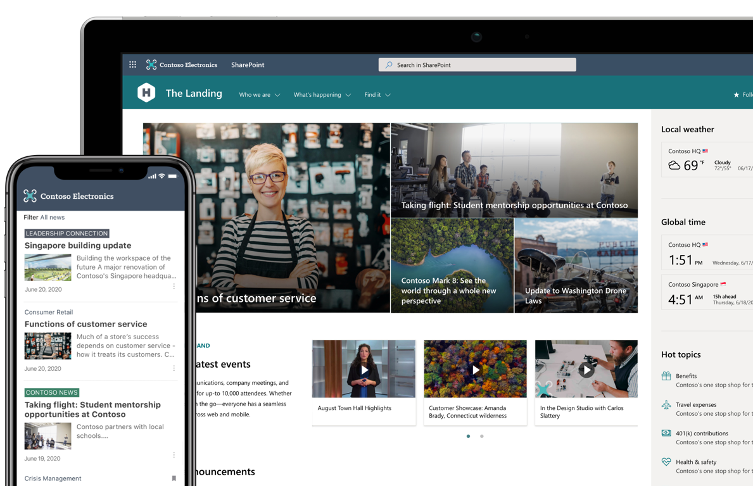
SharePoint Server

Slide 22
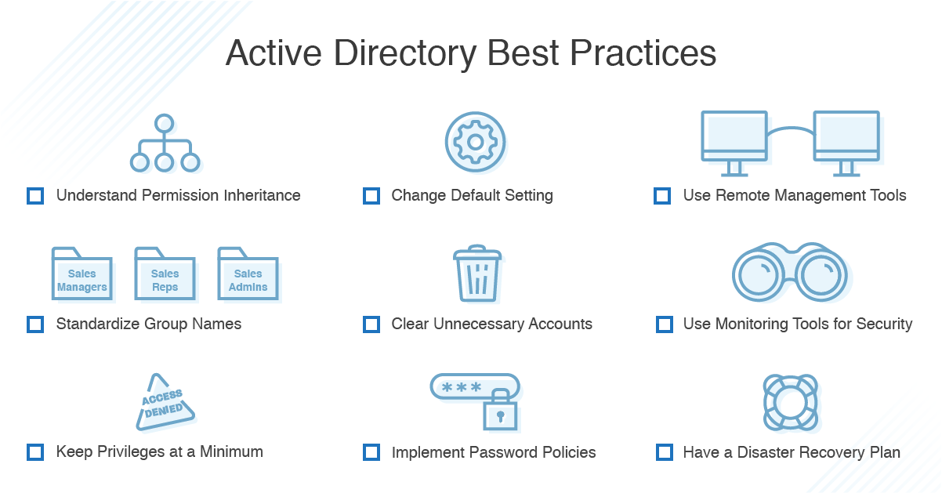
Active Directory Services

Slide 23
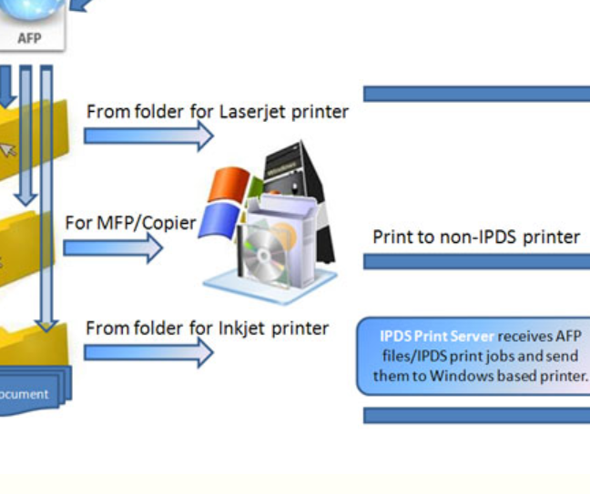
File and Print Servers

Slide 24

SQL Database Server

Slide 25
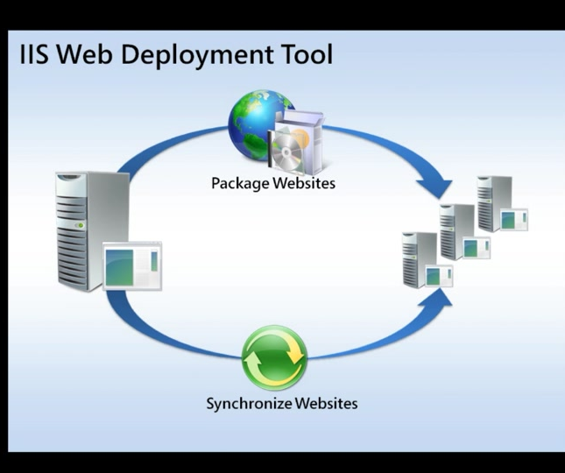
Internet Information Server

Slide 26
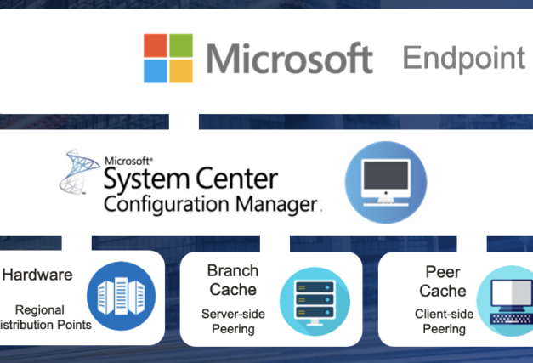
System Center Configuration Manager

Slide 27
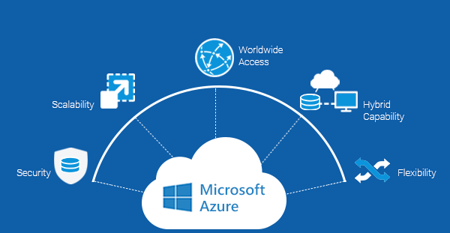
Plus Cloud Computing
Office 365
Azure Cloud Data Center
Partner Services

Slide 28
Ownership
Licensing Overview
Licensing Type

Slide 29
Licensing, Buying, Upgrading and More
Different Methods for Different Markets
  Education
  Enterprise
  Government
  Small Business
  Personal
Microsoft Volume Licensing
  Software Assurance
  Enterprise Agreements
Owning versus “Leasing”

Slide 30
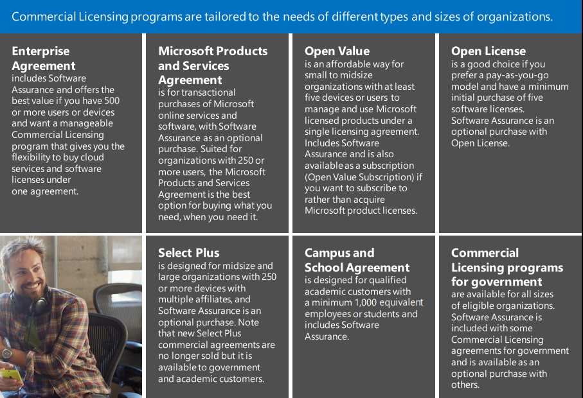
Licensing Types

Slide 31
The Microsoft Toolset for Business
The Complete Technology Stack

